Slide 1
Chapter 18: Parallel Databases

Slide 2
Chapter 18: Parallel Databases
Introduction
I/O Parallelism
Interquery Parallelism
Intraquery Parallelism
Intraoperation Parallelism
Interoperation Parallelism
Design of Parallel Systems

Slide 3
Some || Terminology
Ideal
Xact/sec.
(throughput)
Speed-Up
  Adding more resources results in proportionally less running time for a fixed amount of data.
Scale-Up
  If resources are increased in proportion to an increase in data/problem size, the overall time should remain constant.
degree of ||-ism
Ideal
sec./Xact
(response time)
degree of ||-ism

Slide 4
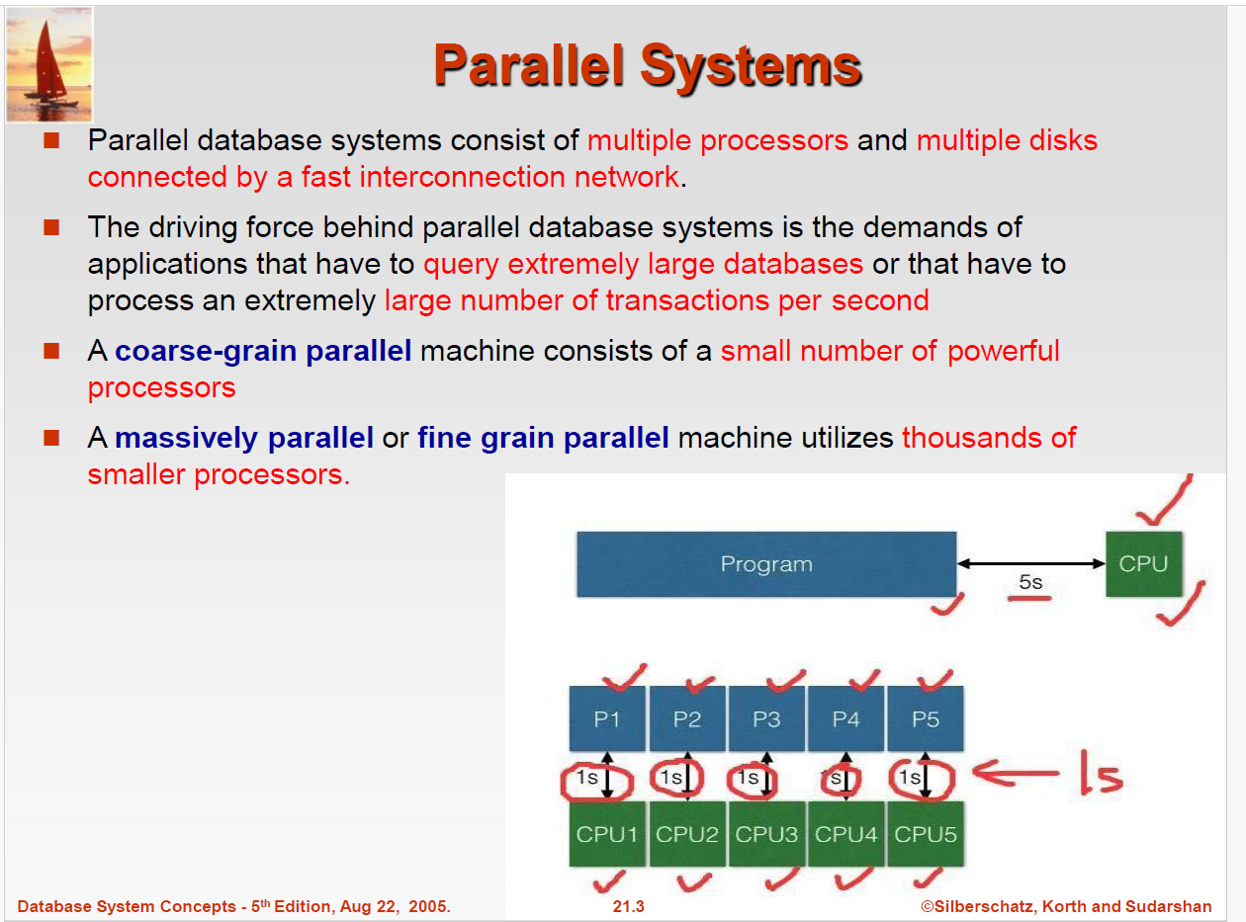


Slide 5
Parallel Systems
Two main performance measures:
throughput ---the number of tasks that can be completed in a given time interval
response time ---the amount of time it takes to complete a single task from the time it is submitted
Notes:
Multicore system
cores are usually integrated into single IC (integrated circuit) die, or onto multiple dies but in single chip package. Thus allowing higher Cache Coherency. With lesser traffic(cores integrated into single chip and will require less time for communication among themselves which is not case with multiple processor system as chips are different so IPC is heavy)
These systems are energy efficient since they allow higher performance at lower energy. A challenge in this, however, is additional overhead of writing parallel code.
Where as in parallel systems with multiple processors
Since more than one processor are working at the same time, throughput will get increased.
More reliable since failure in one CPU does not affect other.
It needs little complex configuration.
Parallel processing

Slide 6
Parallel Database Architectures
Shared memory --processors share a common memory
Shared disk --processors share a common disk
Shared nothing --processors share neither a common memory nor common disk
Hierarchical --hybrid of the above architectures

Slide 7
Architecture Issue: Shared What?
Shared Memory
(SMP)
Shared Disk
Shared Nothing
(network)
CLIENTS
CLIENTS
CLIENTS
Processors
Memory
Easy to program
Expensive to build
Difficult to scale
(Use affinity routing
to approximate SN-
like non-contention)
Hard to program
Cheap to build
Easy to scale
Notes:
101

Slide 8
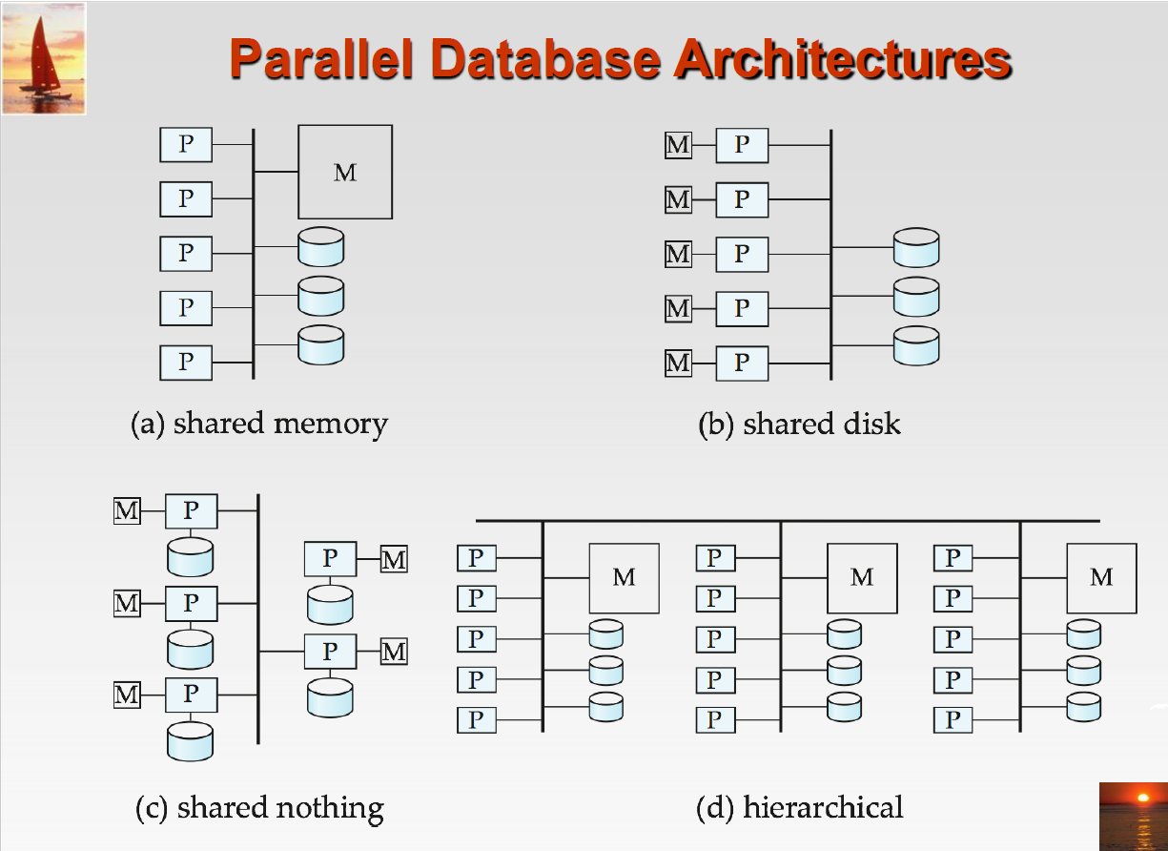

Slide 9
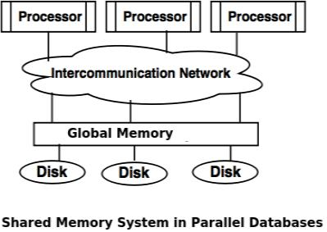
Architecture for parallel databases
Although data may be stored in a distributed fashion( in fragments), the distribution is governed solely by performance considerations. Parallel databases improve processing and input/output speeds by using multiple CPUs and disks in parallel. ... Shared memory architecture.

Slide 10
Why parallelism is needed in database?
Parallel machines are becoming quite common and affordable
  Prices of microprocessors, memory and disks have dropped sharply
  Recent desktop computers feature multiple processors and this trend is projected to accelerate
Databases are growing increasingly large
  large volumes of transaction data are collected and stored for later analysis.
  multimedia objects like images are increasingly stored in databases
Large-scale parallel database systems increasingly used for:
  storing large volumes of data
  processing time-consuming decision-support queries
  providing high throughput for transaction processing

Slide 11
Parallelism in Databases
Data can be partitioned across multiple disks for parallel I/O.
Individual relational operations (e.g., sort, join, aggregation) can be executed in parallel
  data can be partitioned and each processor can work independently on its own partition.
Queries are expressed in high level language (SQL, translated to relational algebra)
  makes parallelization easier.
Different queries can be run in parallel with each other. Concurrency control takes care of conflicts.
Thus, databases naturally lend themselves to parallelism.

Slide 12
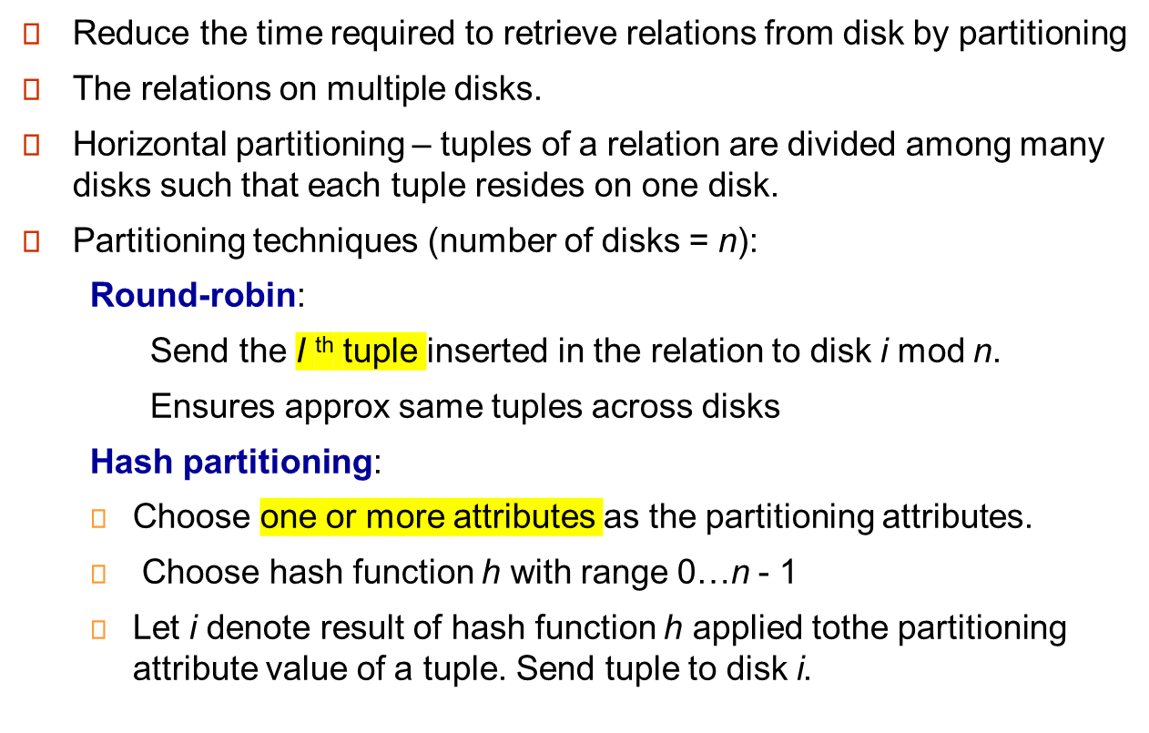
I/O Parallelism

Slide 13
I/O Parallelism (Cont.)
Partitioning techniques (cont.):
Range partitioning:
  Choose an attribute as the partitioning attribute.
  A partitioning vector [v_{o}, v₁, ..., v_{n-2}] is chosen.
  Let v be the partitioning attribute value of a tuple. Tuples such that v_{i} ≤ v_{i+1} go to disk i + 1.
  E.g., range partitioning with 3 disks numbered as 0, 1 and 2 may assign tuples with values less than 5 to disk 0, values between 5 and 40 to disk1 and values greater than 40 to disk 2.
  Example

Slide 14
Comparison of Partitioning Techniques
Evaluate how well partitioning techniques support the following types of data access:
1. Scanning the entire relation.
2. Locating a tuple associatively – point queries.
  E.g., r.A = 25.
3. Locating all tuples such that the value of a given attribute lies within a specified range – range queries.
  E.g., 10 ≤ r.A < 25.

Slide 15
Comparison of Partitioning Techniques (Cont.)
Round robin:
Advantages
  Best suited for sequential scan of entire relation on each query.
  All disks have almost an equal number of tuples; retrieval work is thus well balanced between disks.
Range queries are difficult to process
  No clustering -- tuples are scattered across all disks

Slide 16
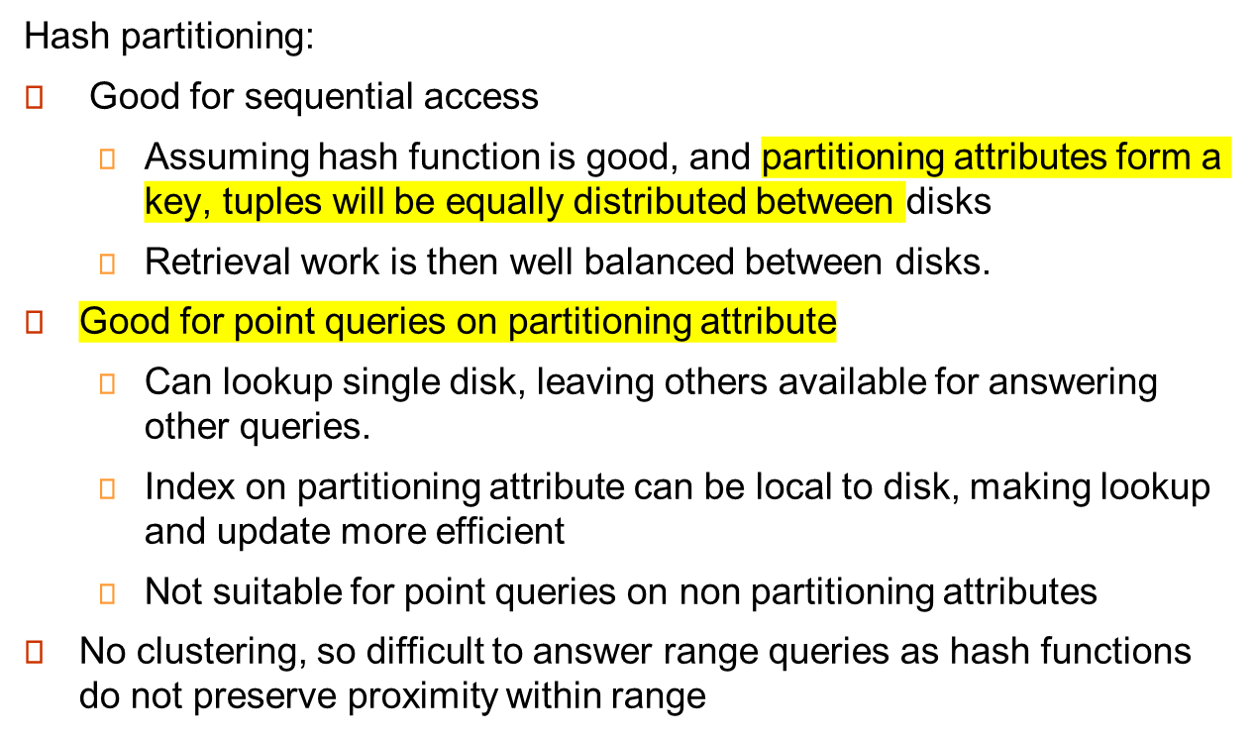
Comparison of Partitioning Techniques (Cont.)

Slide 17
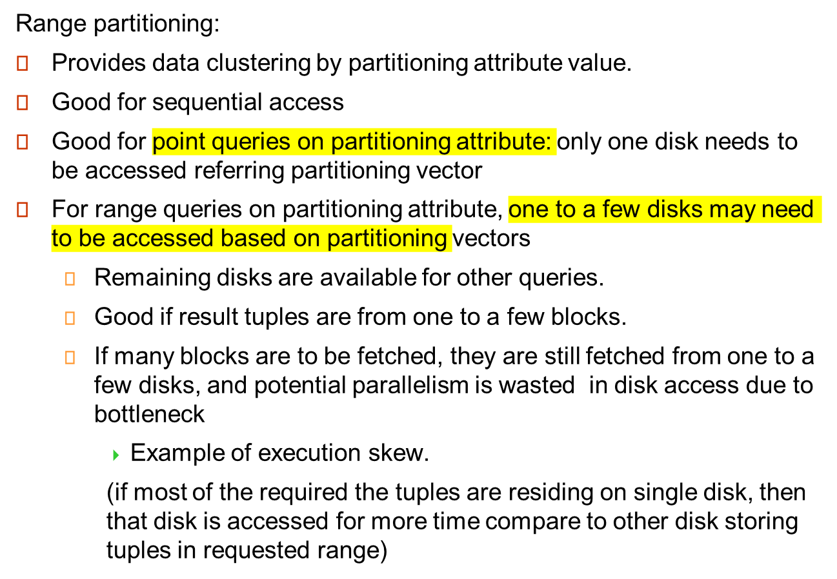
Comparison of Partitioning Techniques (Cont.)

Slide 18
Partitioning a Relation across Disks
If a relation contains only a few tuples which will fit into a single disk block, then assign the relation to a single disk.
Large relations are preferably partitioned across all the available disks.
If a relation consists of m disk blocks and there are n disks available in the system, then the relation should be allocated min(m,n) disks.

Slide 19
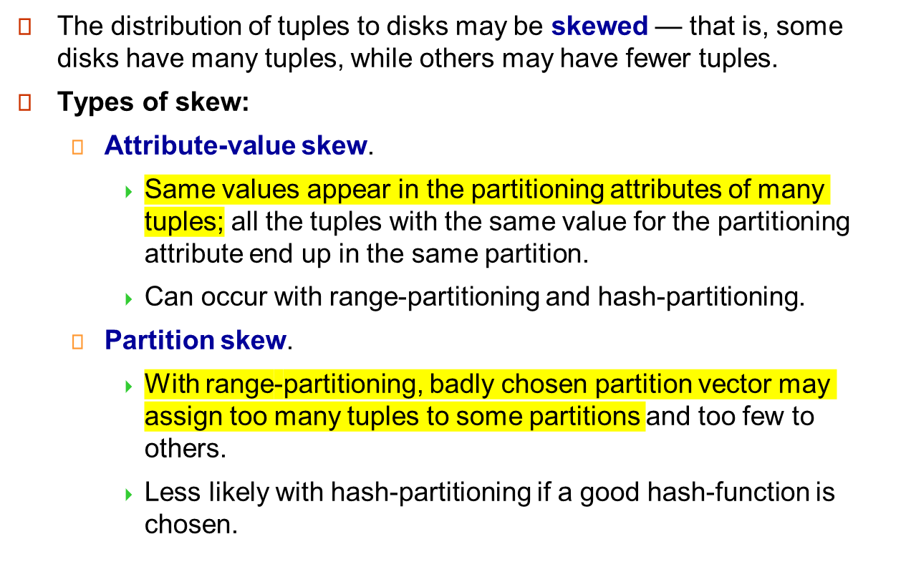
Handling of Skew

Slide 20
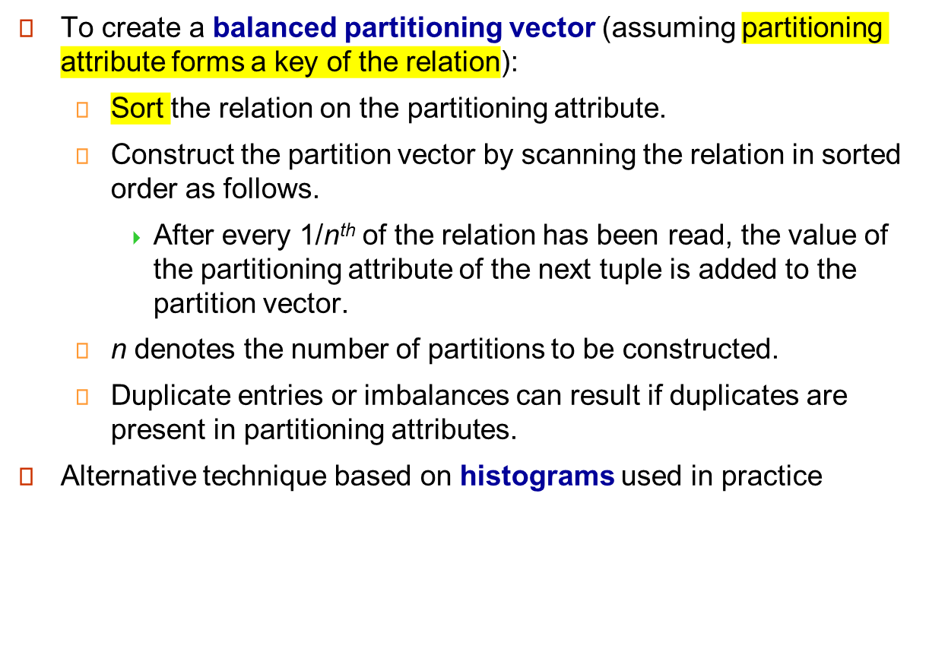
Handling Skew in Range-Partitioning

Slide 21
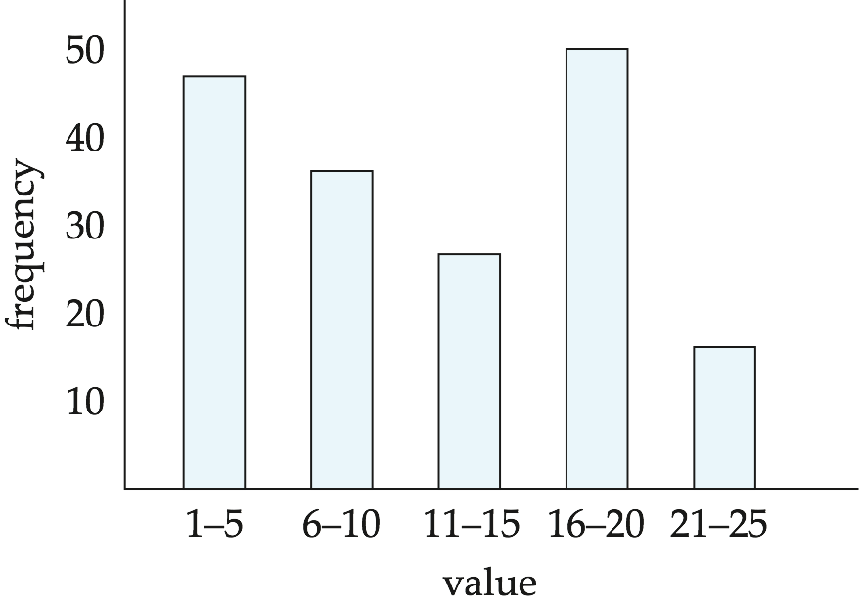
Handling Skew using Histograms
Balanced partitioning vector can be constructed from histogram in a relatively straightforward fashion
  Assume uniform distribution within each range of the histogram
Histogram can be constructed by scanning relation, or sampling (blocks containing) tuples of the relation

Slide 22
Handling Skew Using Virtual Processor Partitioning
Skew in range partitioning can be handled elegantly using virtual processor partitioning:
  create a large number of partitions (say 10 to 20 times the number of processors)
  Instead of real processors virtual processors are mapped to partitions
  And virtual processors are mapped to real processors usually in round-robin fashion
  Basic idea:
  if some range has more tuples than other because of skew then these tuples would get split across multiple virtual processors range.
  And due to round-robin allocation of processors only one processor will not bear all the burden.

Slide 23
Interquery Parallelism
Queries/transactions execute in parallel with one another.
Increases transaction throughput; used primarily to scale up a transaction processing system to support a larger number of transactions per second.
Easiest form of parallelism to support, particularly in a shared-memory parallel database, because even sequential database systems support concurrent processing.
More complicated to implement on shared-disk or shared-nothing architectures
  Locking and logging must be coordinated by passing messages between processors.
  Data in a local buffer may have been updated at another processor.
  Cache-coherency has to be maintained — reads and writes of data in buffer must find latest version of data.
Notes:
Submit batch of transactions and execute each of them in parallel.

Slide 24
Cache Coherency Protocol
Example of a cache coherency protocol for shared disk systems:
  Before reading/writing to a page, the page must be locked in shared/exclusive mode.
  On locking a page, the page must be read from disk
  Before unlocking a page, the page must be written to disk if it was modified.
More complex protocols with fewer disk reads/writes exist.
Cache coherency protocols for shared-nothing systems are similar. Each database page is assigned a home processor. Requests to fetch the page or write it to disk are sent to the home processor.

Slide 25
Intraquery Parallelism
Execution of a single query in parallel on multiple processors/disks; important for speeding up long-running queries.
Two complementary forms of intraquery parallelism:
  Intraoperation Parallelism – parallelize the execution of each individual operation in the query.
  Interoperation Parallelism – execute the different operations in a query expression in parallel.
the first form scales better with increasing parallelism because
the number of tuples processed by each operation is typically more than the number of operations in a query.

Slide 26
Parallel Processing of Relational Operations
Our discussion of parallel algorithms assumes:
  read-only queries(so no read write conflit)
  shared-nothing architecture
  n processors, P₀, ..., P_{n-1}, and n disks D₀, ..., D_{n-1}, where disk D_{i} is associated with processor P_{i}.
If a processor has multiple disks they can simply simulate a single disk D_{i}.
Shared-nothing architectures can be efficiently simulated on shared-memory and shared-disk systems.
  Algorithms for shared-nothing systems can thus be run on shared-memory and shared-disk systems.
  However, some optimizations may be possible.
Notes:
Disk and memory in share memory can be partitioned and assigned to individual processor to simulate share nothing

Slide 27
Parallel Sort
Range-Partitioning Sort
Choose processors P₀, ..., P_{m}, where m ≤ n -1 to do sorting.
Create range-partition vector with m entries, on the sorting attributes
Redistribute the relation using range partitioning
  all tuples that lie in the i^{th} range are sent to processor P_{i}
  P_{i} stores the tuples it received temporarily on disk D_{i}.
  This step requires I/O and communication overhead.
Each processor P_{i} sorts its partition of the relation locally.
Each processors executes same operation (sort) in parallel with other processors, without any interaction with the others (data parallelism).
Final merge operation is trivial: range-partitioning ensures that,for i, j m, the key values in processor P^{i} are all less than the key values in P_{j}.
Notes:
Initial partitioning may not be compatible to sort
So we need to formulate partitioning vector
And then may have to read the typles in particular partition for particular processor from multiple processors related disks
This is overhead of communication and IO within disks

Slide 28
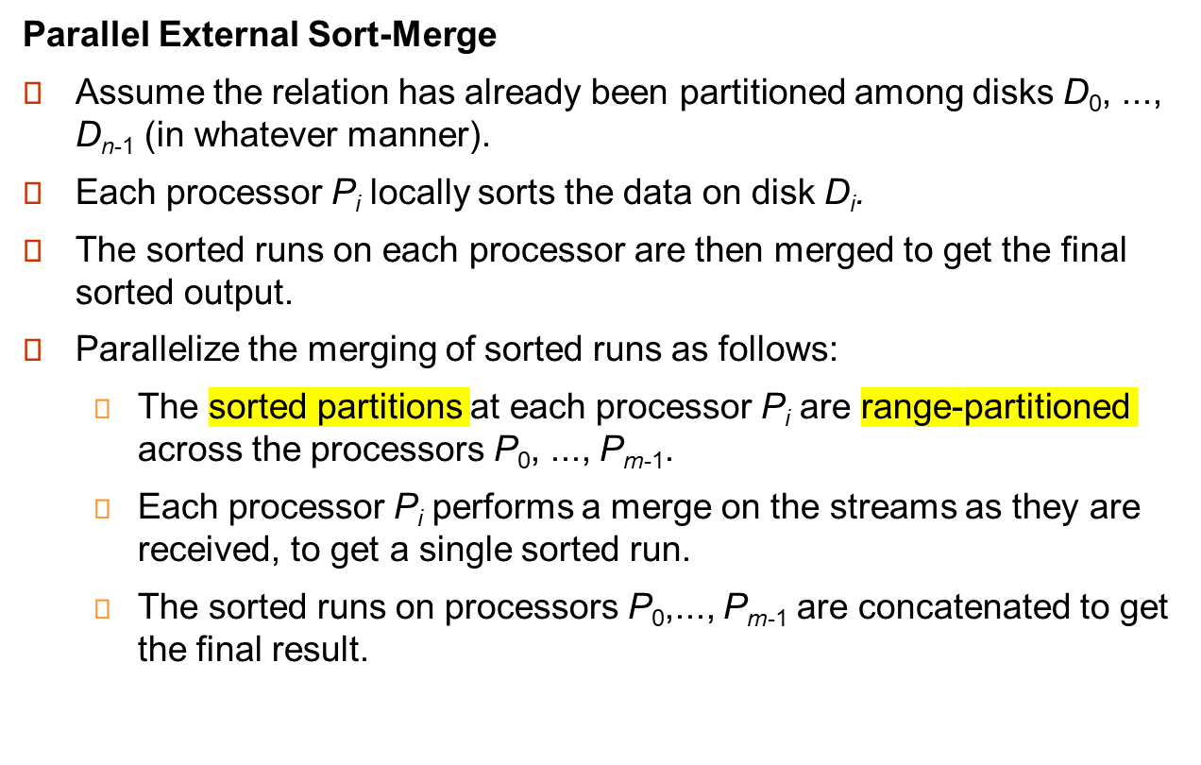
Parallel Sort (Cont.)
Notes:
Sorting as per stored partitions locally(may not be in order)
Then range partitioning these. So each processor may respond with slice of relation in that range.
As per partition vector these ranges are assigned to processors
Then each processor will merge these slices as and when received.
Finally collect merged data of each processor to get final sorted relation

Slide 29
Parallel Join
The join operation requires pairs of tuples to be tested to see if they satisfy the join condition, and if they do, the pair is added to the join output.
Parallel join algorithms attempt to split the pairs to be tested over several processors. Each processor then computes part of the join locally.
In a final step, the results from each processor can be collected together to produce the final result.

Slide 30
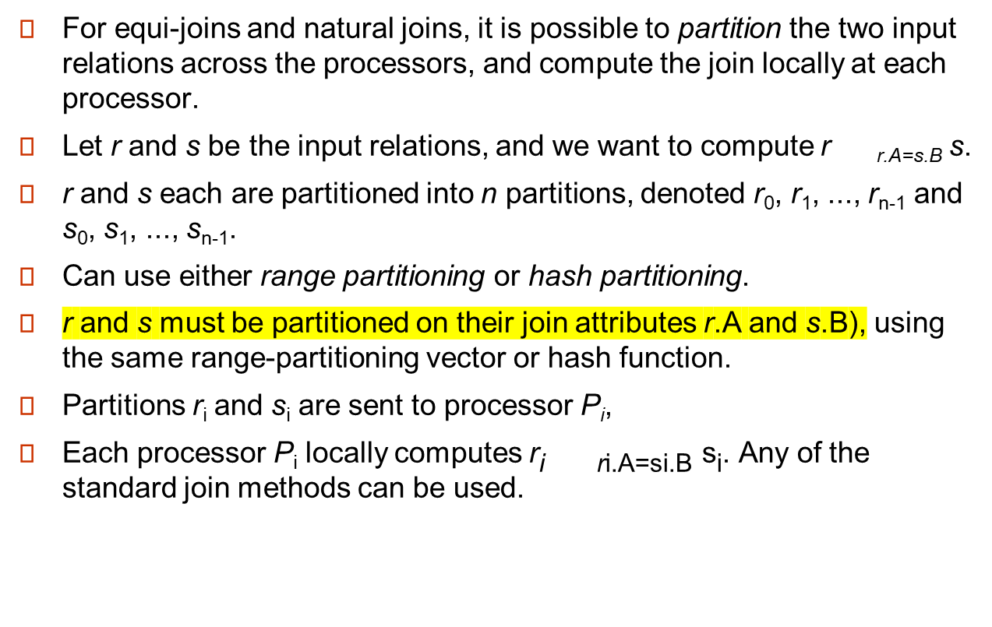
Partitioned Join

Slide 31
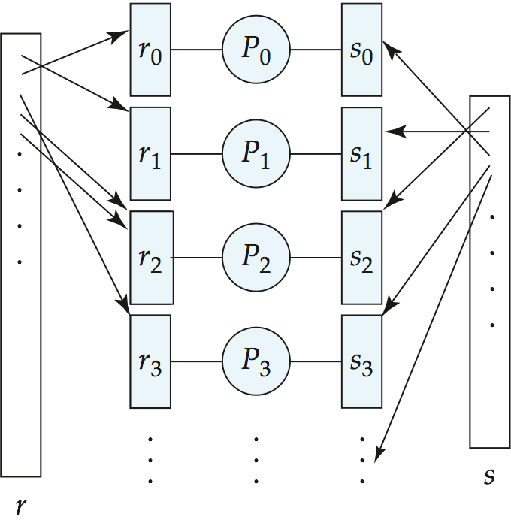
Partitioned Join (Cont.)

Slide 32
Fragment-and-Replicate Join
Partitioning not possible for some join conditions
  E.g., non-equijoin conditions, such as r.A > s.B.
For joins where partitioning is not applicable, parallelization can be accomplished by fragment and replicate technique
  It is possible that all tuples in relation r will join with some tuples in relation s
Special case – asymmetric fragment-and-replicate:
  One of the relations, say r, is partitioned; any partitioning technique can be used.
  The other relation, s(build relation) is replicated across all the processors.
  Processor P_{i} then locally computes the join of r_{i} with all of s using any join technique.

Slide 33
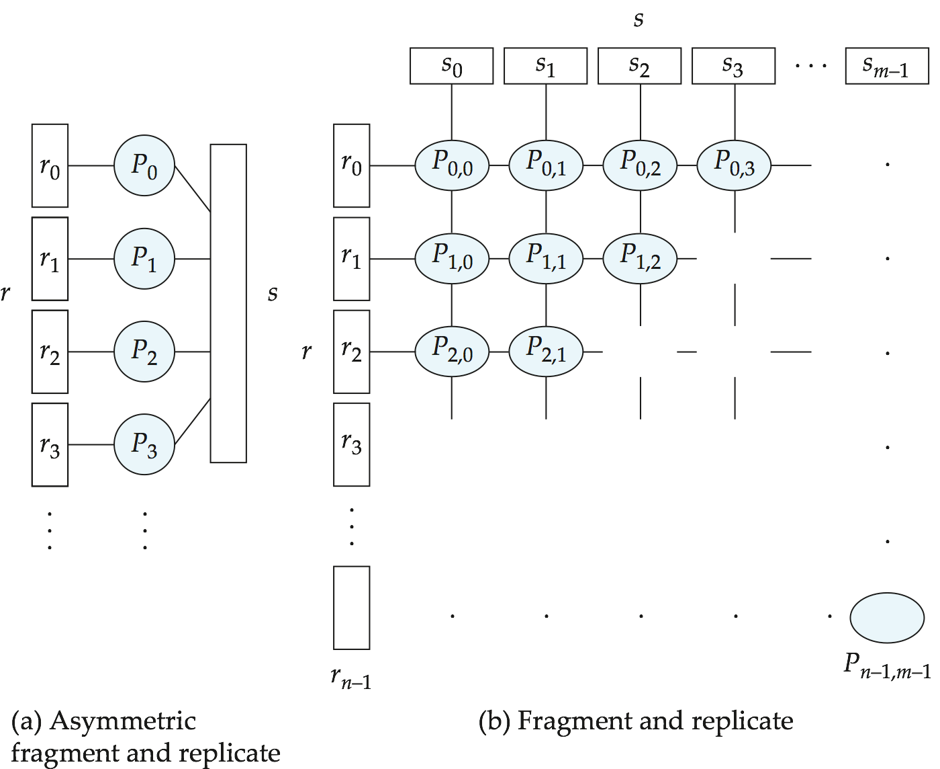
Depiction of Fragment-and-Replicate Joins
r.age<=s.age
Age 25-35
Age 36-45
Age4646-55
Age4656-65
Age 25-35

Slide 34
Fragment-and-Replicate Join (Cont.)
General case: reduces the sizes of the relations at each processor.
  r is partitioned into n partitions,r₀, r₁, ..., r _{n-1};s is partitioned into m partitions, s₀, s₁, ..., s_{m-1}.
  Any partitioning technique may be used.
  There must be at least m * n processors.
  Label the processors as
  P_{0,0}, P_{0,1}, ..., P_{0,m-1}, P_{1,0}, ..., P_{n-1m-1}.
  P_{i,j} computes the join of r_{i} with s_{j}. In order to do so, r_{i} is replicated to P_{i,0}, P_{i,1}, ..., P_{i,m-1}, while s_{i} is replicated to P_{0,i}, P_{1,i}, ..., P_{n-1,i}
  Any join technique can be used at each processor P_{i,j}.

Slide 35
Fragment-and-Replicate Join (Cont.)
Both versions of fragment-and-replicate work with any join condition, since every tuple in r can be tested with every tuple in s.
Usually has a higher cost than partitioning, since one of the relations (for asymmetric fragment-and-replicate) or both relations (for general fragment-and-replicate) have to be replicated.
Sometimes asymmetric fragment-and-replicate is preferable even though partitioning could be used.
  E.g., say s is small and r is large, and already partitioned. It may be cheaper to replicate s across all processors, rather than repartition r and s on the join attributes.

Slide 36
Partitioned Parallel Hash-Join
Parallelizing partitioned hash join:
Assume s is smaller than r and therefore s is chosen as the build relation.
A hash function h₁ takes the join attribute value of each tuple in s and maps this tuple to one of the n processors.
Each processor P_{i} reads the tuples of s that are on its disk D_{i}, and sends each tuple to the appropriate processor based on hash function h₁. Let s_{i} denote the tuples of relation s that are sent to processor P_{i}.
As tuples of relation s are received at the destination processors, they are partitioned further using another hash function, h₂, which is used to compute the hash-join locally. (Cont.)

Slide 37
Partitioned Parallel Hash-Join (Cont.)
Once the tuples of s have been distributed, the larger relation r is redistributed across the m processors using the hash function h₁
  Let r_{i} denote the tuples of relation r that are sent to processor P_{i}.
As the r tuples are received at the destination processors, they are repartitioned using the function h₂
Each processor P_{i} executes the build and probe phases of the hash-join algorithm on the local partitions r_{i} and si of r and s to produce a partition of the final result of the hash-join.
Note: Hash-join optimizations can be applied to the parallel case
  e.g., the hybrid hash-join algorithm can be used to cache some of the incoming tuples in memory and avoid the cost of writing them and reading them back in.
Notes:
hash tuple’s join key of R and probe into hash table built from s
where S is build relation and R is probe relation
Build relation is used to build hash table

Slide 38
Parallel Nested-Loop Join
Assume that
  relation s is much smaller than relation r and that r is stored by partitioning.
  there is an index on a join attribute of relation r at each of the partitions of relation r.
Use asymmetric fragment-and-replicate, with relation s being replicated, and using the existing partitioning of relation r.
Each processor P_{j} where a partition of relation s is stored reads the tuples of relation s stored in D_{j}, and replicates the tuples to every other processor P_{i}.
  At the end of this phase, relation s is replicated at all sites that store tuples of relation r.
Each processor P_{i} performs an indexed nested-loop join of relation s with the i^{th} partition of relation r.

Slide 39
Other Relational Operations
Selection σ_{θ}(r)
If θ is of the form a_{i} = v, where a_{i} is an attribute and v a value.
  If r is partitioned on a_{i} the selection is performed at a single processor.
If θ is of the form l <= a_{i} <= u (i.e., θ is a range selection) and the relation has been range-partitioned on a_{i}
  Selection is performed at each processor whose partition overlaps with the specified range of values.
In all other cases: the selection is performed in parallel at all the processors.

Slide 40
Other Relational Operations (Cont.)
Duplicate elimination
  Perform by using either of the parallel sort techniques
    eliminate duplicates as soon as they are found during sorting.
  Can also partition the tuples (using either range- or hash- partitioning) and perform duplicate elimination locally at each processor.
Projection
  Projection without duplicate elimination can be performed as tuples are read in from disk in parallel.
  If duplicate elimination is required, any of the above duplicate elimination techniques can be used.

Slide 41
Other Relational Operations (Cont.)
Duplicate elimination
  Perform by using either of the parallel sort techniques
    eliminate duplicates as soon as they are found during sorting.
  Can also partition the tuples (using either range- or hash- partitioning) and perform duplicate elimination locally at each processor.
Projection
  Projection without duplicate elimination can be performed as tuples are read in from disk in parallel.
  If duplicate elimination is required, any of the above duplicate elimination techniques can be used.

Slide 42
Grouping/Aggregation
Partition the relation on the grouping attributes and then compute the aggregate values locally at each processor.
Can reduce cost of transferring tuples during partitioning by partly computing aggregate values before partitioning.
Consider the sum aggregation operation:
  Perform aggregation operation at each processor P_{i} on those tuples stored on disk D_{i}
    results in tuples with partial sums at each processor.
  Result of the local aggregation is partitioned on the grouping attributes, and the aggregation performed again at each processor P_{i} to get the final result.
Fewer tuples need to be sent to other processors during partitioning.

Slide 43
Cost of Parallel Evaluation of Operations
If there is no skew in the partitioning, and there is no overhead due to the parallel evaluation, expected speed-up will be 1/n
If skew and overheads are also to be taken into account, the time taken by a parallel operation can be estimated as
  T_{part} + T_{asm} + max (T₀, T₁, …, T_{n-1})
  T_{part} is the time for partitioning the relations
  T_{asm} is the time for assembling the results
  T_{i} is the time taken for the operation at processor P_{i}
    this needs to be estimated taking into account the skew, and the time wasted in contentions.

Slide 44
Interoperator Parallelism
Pipelined parallelism
  Consider a join of four relations
    r₁ r₂ r₃ r₄
  Set up a pipeline that computes the three joins in parallel
    Let P1 be assigned the computation of
    temp1 = r₁ r₂
    And P2 be assigned the computation of temp2 = temp1 r₃
    And P3 be assigned the computation of temp2 r₄
  Each of these operations can execute in parallel, sending result tuples it computes parallelly to the next operation even as it is computing further results
    Provided a pipelineable join evaluation algorithm (e.g., indexed nested loops join) is used

Slide 45
Factors Limiting Utility of Pipeline Parallelism
Pipeline parallelism is useful since it avoids writing intermediate results to disk
Useful with small number of processors, but does not scale up well with more processors. One reason is that pipeline chains do not attain sufficient length.
Cannot pipeline operators which do not produce output until all inputs have been accessed (e.g., aggregate and sort)
Little speedup is obtained for the frequent cases of skew in which one operator's execution cost is much higher than the others.
Notes:
For one operator if its taking long time then we can execute other smallar tasks by that time and then combine it with result of long running opertation

Slide 46
Independent Parallelism
Independent parallelism
  Consider a join of four relations
    r₁ r₂ r₃ r₄
    Let P₁ be assigned the computation of
    temp1 = r₁ r₂
    And P₂ be assigned the computation of temp2 = r₃ r₄
    And P₃ be assigned the computation of temp1 temp₂
    P₁ and P₂ can work independently in parallel
    P₃ has to wait for input from P₁ and P₂
      Can pipeline output of P₁ and P₂ to P₃, combining independent parallelism and pipelined parallelism
  Does not provide a high degree of parallelism
    useful with a lower degree of parallelism.
    less useful in a highly parallel system.

Slide 47
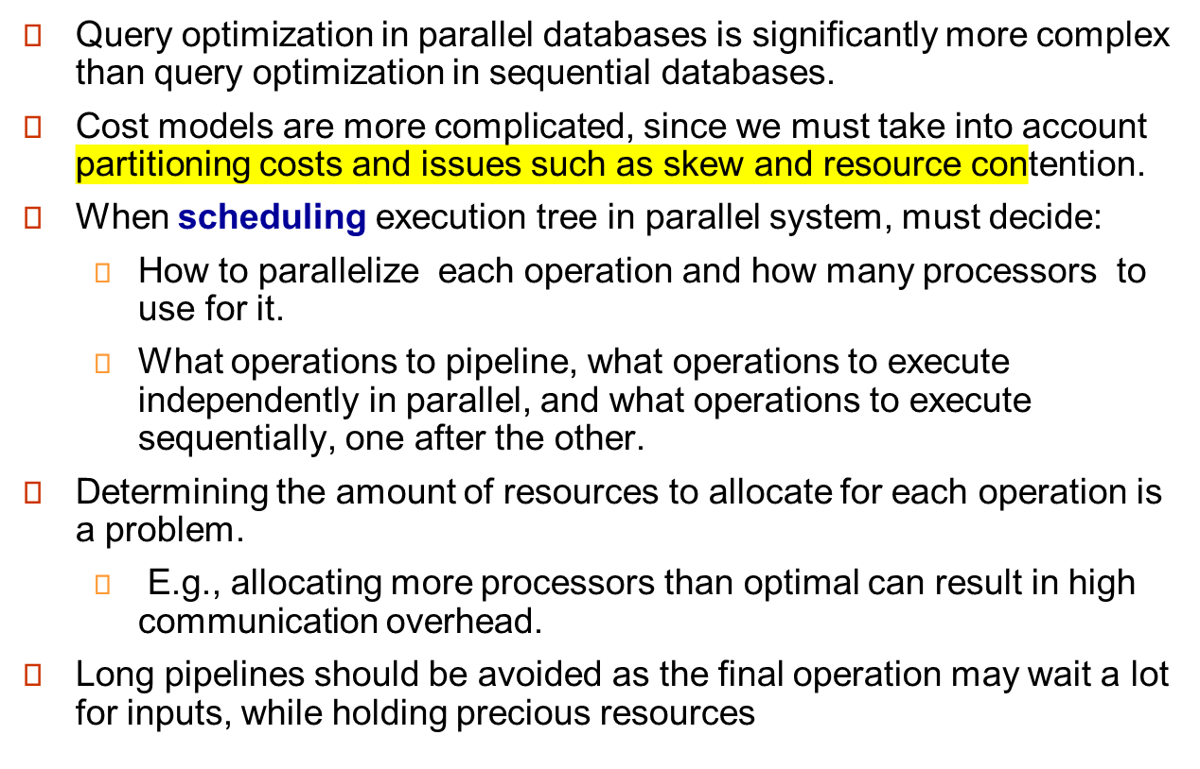
Query Optimization

Slide 48
Query Optimization (Cont.)
The number of parallel evaluation plans from which to choose from is much larger than the number of sequential evaluation plans.
  Therefore heuristics are needed while optimization
Two alternative heuristics for choosing parallel plans:
  No pipelining and inter-operation pipelining; just parallelize every operation across all processors.
    Finding best plan is now much easier --- use standard optimization technique, but with new cost model
    Volcano parallel database popularize the exchange-operator model
      exchange operator is introduced into query plans to partition and distribute tuples
      each operation works independently on local data on each processor, in parallel with other copies of the operation
  First choose most efficient sequential plan and then choose how best to parallelize the operations in that plan.
    Can explore pipelined parallelism as an option
Choosing a good physical organization (partitioning technique) is important to speed up queries.

Slide 49
Design of Parallel Systems
Some issues in the design of parallel systems:
Parallel loading of data from external sources is needed in order to handle large volumes of incoming data.
Resilience to failure of some processors or disks.
  Probability of some disk or processor failing is higher in a parallel system.
  Operation (perhaps with degraded performance) should be possible in spite of failure.
  Redundancy achieved by storing extra copy of every data item at another processor.

Slide 50
Design of Parallel Systems (Cont.)
On-line reorganization of data and schema changes must be supported.
  For example, index construction on terabyte databases can take hours or days even on a parallel system.
    Need to allow other processing (insertions/deletions/updates) to be performed on relation even as index is being constructed.
  Basic idea: index construction tracks changes and “catches up” on changes at the end.
Also need support for on-line repartitioning and schema changes (executed concurrently with other processing).

Slide 51
End of Chapter

Slide 52
Figure 18.01

Slide 53
Figure 18.02

Slide 54
Figure 18.03

